Slide 1
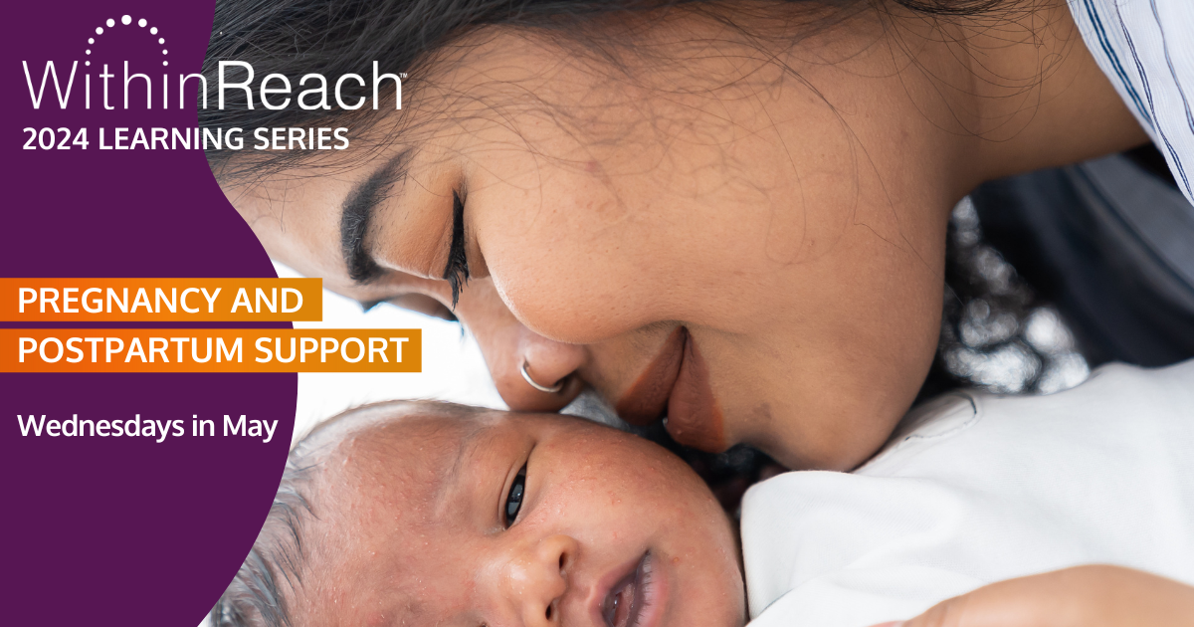
TITLE SLIDE: Photo Option 3
[Copy photo & replace photo on Title Slide: Option 1]

Slide 3
We want to acknowledge that we occupy the ancestral lands of the Coast Salish Peoples, in particular the Tulalip, Snohomish, Stillaguamish, Suquamish, Muckleshoot, Nisqually, Puyallup, and the first people of Seattle, the Duwamish People, past, present and future. We honor with gratitude the land itself.
We also want to recognize that the United States as we know it was built at the often-fatal expense of forcefully enslaved Black and Indigenous people. We must acknowledge that much of what we know of this country today, including its culture, economic growth, and development has been made possible by the labor of enslaved Africans, their descendants, and Indigenous peoples past and present. Today, we are indebted to their labor and the labor of many Black and brown bodies that continue to work in the shadows for our collective benefit.
Land and Labor Acknowledgement
2024 Learning Series: Pregnancy and Postpartum Support

Slide 5
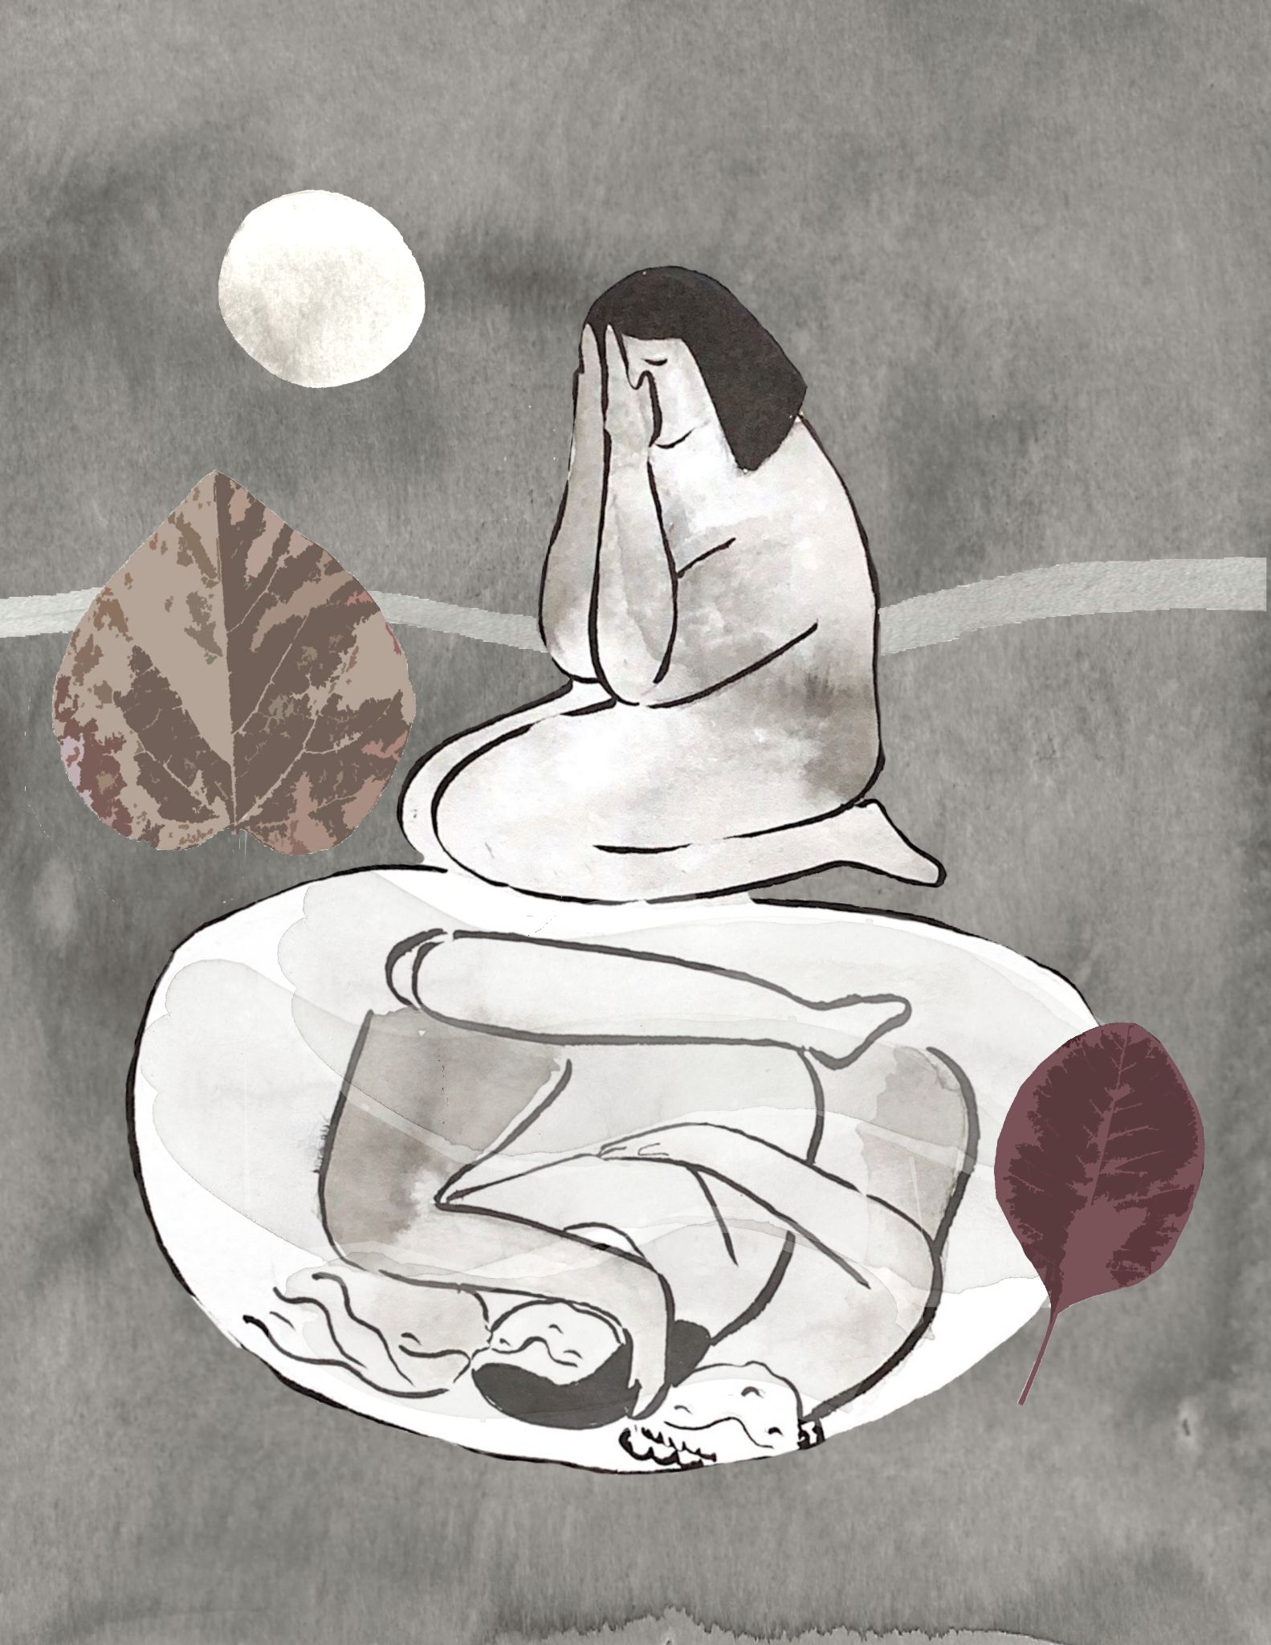
“I recognize the growth I’ve had since [starting PERC];
I am able to recognize triggers, why they are happening, and can question how they impact the story I tell myself about me.”

Slide 6
Our Mission:
Shining the light on perinatal mental health to support all families and communities.
We go about this is by:
1. Raising Awareness
2. Educating Professionals.
3. Supporting families
4. Fostering connections between all.
Supporting WA Care Providers & Families Since 1989
Support resources found all over Washington
Notes:
Mission:
Shining the light on perinatal mental health to strengthen all families and communities.
We know that 1 in 5 birthing parents and 1 in 10 dads will be diagnosed with a perinatal mood and anxiety disorder
Infact a PMAD is teh #1 most common complication of pregnancy and childbirth.
Culture of shame and guilt and isolation- Parents should be able to do and handle it all, which we know is actually not possible.
and we know that 75% of those birthing parents do not get the care they need.
Suicide and overdose are the leading cause of death in the first year postpartum.
So that is why we are here working to bring awareness around perinatal mental health issues and services to those who need them
We go about this is by raising awareness, educating those who work with parents in the perinatal period (trying to conceive through 2 years postpartum, supporting parents through our direct services and fostering connections between all

Slide 7
Peer Support Warm Line 1-888-404-PPMD (7763)
Free brochures “Wondering if it’s Supposed to be this Hard?” (english and spanish)
Directory/Health Care provider referrals
Trainings, in-services & conferences
Therapy program (clinical training program)
Parent support groups
Peer Support via the Parent Resilience Program in King/Skagit County (PERC)
Professional membership
Consultation for organizations & health care providers
Online resources and downloads
Online newsletter
OUR PROGRAMS
Notes:
Here is a list of all of out our programs, Some of which I will go into depth. the the ones I won’t I will mention here
Free Brochures “Wondering if it is supposed to be this hard”
English or spanish
can order as many as you want to give out, some hospitals give it in their discharge folder to new parents, in childbirth ed classes, health clinics, etc -
talks about the MH struggles parents might face, tips on how to manage, our services and our WL number
Can order on our website
Perinatal Resilience Program- peer support in King County that is funded through the county
Professional Membership
Consultation for Organizations and Health Care Providers- on PMADs, screenings, etc
Online resources on our website
Our Newsletter: 1 for parents and 1 for professionals

Slide 8
Warm Line
Call, text & email
Live Answer Monday-Friday 9am-4:30pm
Respond to voicemail messages evenings and weekends
Bi-lingual/Bi-cultural Spanish speaking staff
For parents, family and providers
Dad’s too! (via our Dad Specialist)
888.404.7763
Notes:
Warm Line-
Our statewide parent support WL was started in 1991 by parents, so no parent ever had to feel alone again.
Here are some of the logistics about the Warm Line:
The WL can be reached via
phone call,
text,
email,
we also have a form on our website to request a call back-
we want to have as little barriers as possible for people to reach us.
The Warm Line is answered live during weekday business hours in English and Spanish
We have a spanish Warm Line with a dedicated staff person.
The other languages we can cover via our volunteers is Portuguese and Hebrew, but we have more coming soon!
We don’t want to leave parents hanging, so we have volunteers who cover evenings and weekends.
Calls go to VM and volunteers call back usually by that evening but definitely within 14 hours
Anyone can reach out to the warm Line-
parents,
family members (we get a number of grandparents reaching out for how to support their loved ones)
Providers, case managers etc- for resource for specific clients and information on PMH
And we support dad’s too in all the ways we support moms. We have a dad specialist who is available to offer peer support. So when dads call they can request to speak with him.
Call Volume

Slide 9
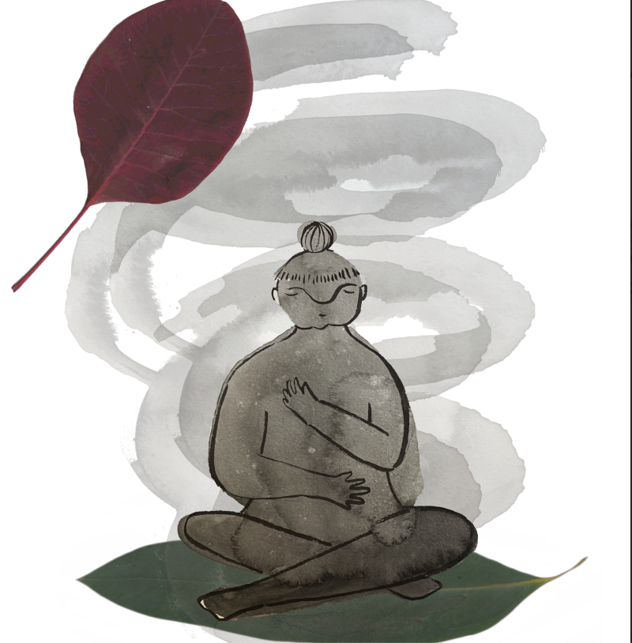
Clinical Therapy Program
Staffed by interns, externs and staff therapists
Services available regardless of income or insurance
Offer free and sliding scale
Usually have a waiting list
In network with:
Premera
Lifewise
First Choice
Kaiser PPO
Cigna
Molina
Aetna
Apple Health/ Medicaid
Notes:
we use interns, externs, and staff therapists to provide therapy and offer extensive training on PMH issues.
Telehealth therapy for people trying to conceive through 24 months postpartum.
We are currently in network with Premera, Lifewise, Cigna, Molina, Aetna, Kaiser PPO, first choice and Apple Health/Medicaid
But Services available regardless of income or insurance.
We offer SLIDING SCALE & FREE THERAPY
We can complete a benefit check to determine your out-of-pocket costs, as well as determine a sliding scale option that will work for you.
We have a full time Spanish speaking and bicultural therapist
Currently we are full (after almost 5 months of being open and taking clients) and have a waitlist for all insurances, Medicaid, sliding scale, and pro bono
But we have a few slots available for a Spanish speaking parents
New cohort of interns and externs starting in May so our availability should open up a bit sometime in May.
Warm Line is here to help find therapists outside PS-W
Usually have a wait list but right now we are open for Medicaid, sliding scale, and probono

Slide 10
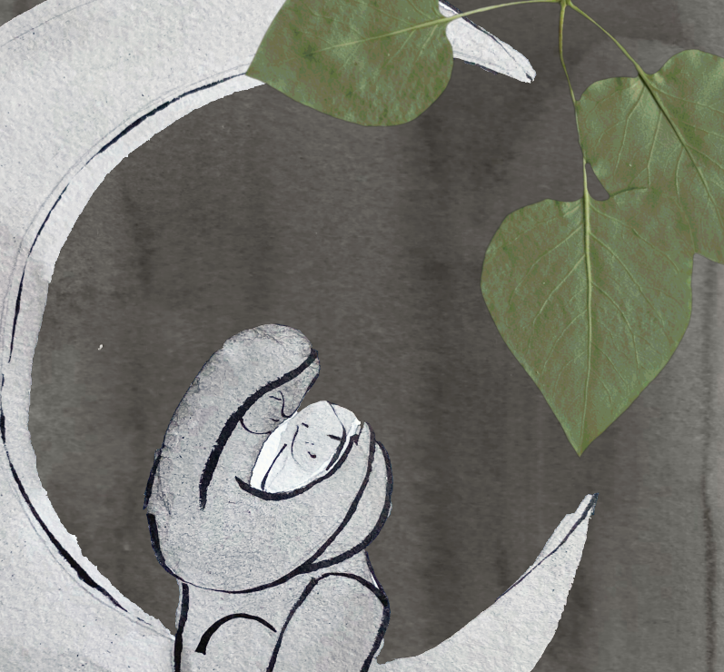
Parent Resilient Program (PERC)
in King and Skagit Counties
Parent Resilience Specialists (PRS):
Support via phone, text, video chat & in-person
As many weeks or months as needed
Culturally-matched peer mental health support
Offer tailored, creative, and flexible wellness strategies by working together to identify and support individuals.
“I feel more confident in my parenting and my experience as an immigrant parent felt more normalized and (My PRS) has been able to help me get connected to more social support”

Slide 11
Serve pregnant people and new parents who are at risk, or experiencing, mental health concerns related to childbearing
Provide culturally-matched services to three specific populations (Indigenous, Latinx, and US-Born Black/African American) in two languages (English & Spanish)
Parent Resilience Program
(PERC)
Also support people who:
have experienced a loss, terminated a pregnancy, or had other unexpected childbirth outcomes.
parents not currently parenting due to loss, removal, etc. if they are experiencing perinatal mental health concern.
“[PERC has] helped me feel more focused on myself and family, I’m feeling less impacted by judgement/anxiety”
Notes:
Also supports people who have experienced a loss, terminated a pregnancy, or had other unexpected childbirth outcomes and may not consider themselves parents and parents who are not currently parenting due to loss, removal, etc. are also welcome in this program if they are experiencing perinatal mental health concern.

Slide 12
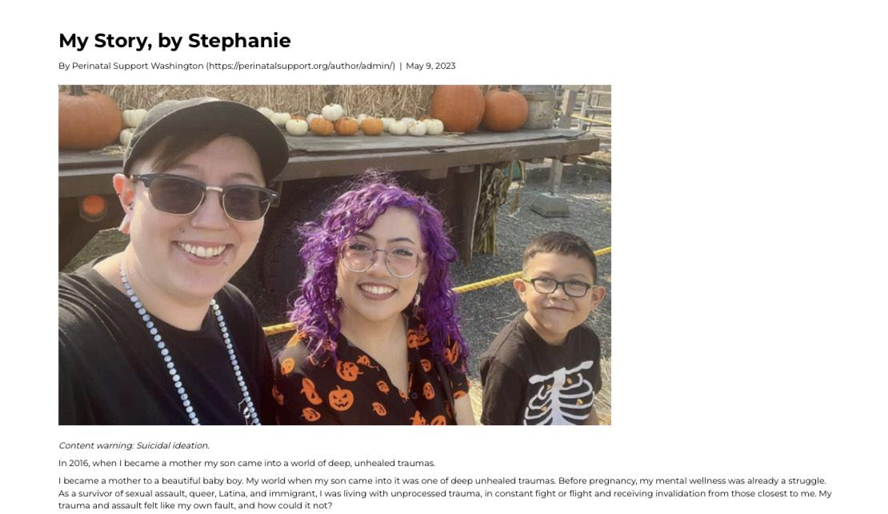
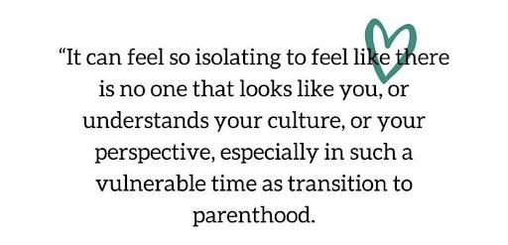
Culturally Matched Peer Support
As a queer, Latina, and immigrant survivor of sexual assault, when I become a mother my unhealed traumas, and the systemic challenges I faced led me to developing post partum depression, and anxiety.
Already feeling like I wasn’t good enough, I lost myself as a person, I was a hollow provider to my baby. I felt riddled with guilt over everything. I had to be an exemplary Latina and mother and when I couldn’t be, I came to the conclusion that my baby was better of without me.
The path to healing wasn’t easy, it can be painful to advocate for yourself only to be met with biases, shame and oppressive systems. Learning how to advocate for yourself in a system that does not see the whole you while also being the first person in your family to address trauma, is an isolating experience.
Healing shifted for me when I was able to get connected to a therapist who understood where I come from, as an immigrant, as a survivor, the layers of my identity and how they have affected my mental health and what the system had allowed me to do about it.
That is why I am passionate about my work here at PS-WA. I now use my lived experience and training to support and advocate for Latinx moms on their healing journey, lending an ear and affirming them in their experiences as they navigate the perinatal period. I believe in the power of sharing our stories, to reduce stigma, and end healing in isolation.

Slide 13
How to Refer to PS-WA Programs
Visit our website to make a referral or reach out to our Warm Line to discuss options for your client.
Not sure what’s available? Not sure where to send a parent? Refer to the Warm Line!
888.404.7763
www.perinatalsupport.org
Notes:
How to refer to PS-WA programs
Providers can refer clients through a form on our website or call our warm line for more information
If you know you want to refer them to the Warm Line, PERC or Thereapy program the quickest option is to fill out the referral form on our website.
parents can also fill out a form on our website or call the WArm Line
But when in doubt, the WArm Line is the entry point for all our programs.

Slide 14
Z is appreciative of having this space to speak with someone in her native language with a similar experience as her, after spending time with other providers judging her for her choices. She also expressed appreciating that PERC connected with her quickly, and also identified with her experience, provided validation and took time to listen in a supportive manner unlike other programs/supports. "Me ayuda saber que existes tu"
Notes:
Here is another quote from a WL caller, but I think it goes to how we create all our programs at PS-WA, to break down that shame and offer a safe space for parents.

Slide 15
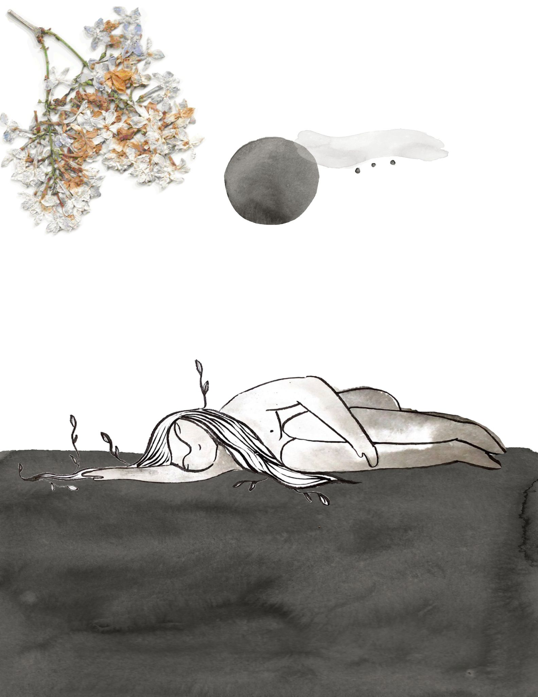
“I was able to open up and discuss feelings in way I had not before. [She] reports improved communication with husband, and appreciated having safe space that was her own to speak freely. M is now pursuing several personal goals and wanting to do more professionally.”
E shared that she feels she has learned a lot from our time together and has appreciated PRS’s willingness to discuss own experience, along with validating hers. E feels that without this program she would not have the strength or the tools, to take on what lies ahead… [she] feels more prepared to take it on, and is feeling confident in her next steps.
“S feeling focused on herself and family, feeling less impacted by judgement/anxiety”
“Y is feeling less intensity in her anxiety, as we have been able to talk in sessions and address where some of her anxiety was coming from. Y feels more confidence in taking on her next challenges. Y spoke of feeling less anxiety over a separation with her baby happening.”
Notes:
Questions? Comments?

Slide 16
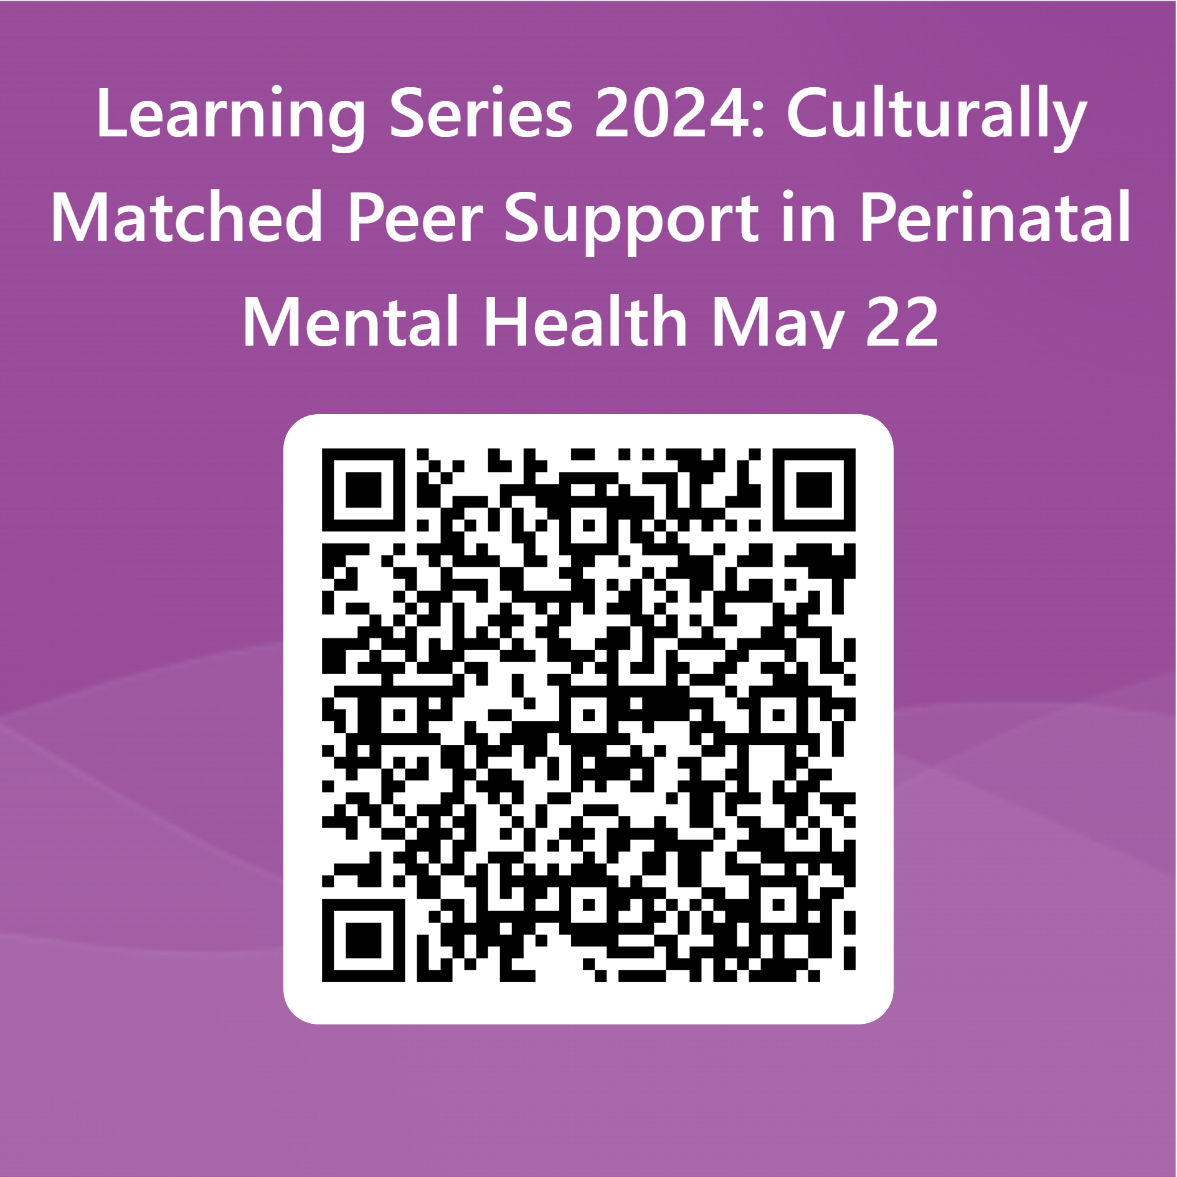
Thank you for attending today's session
We want to hear from you. Please fill out the survey.

