Slide 1
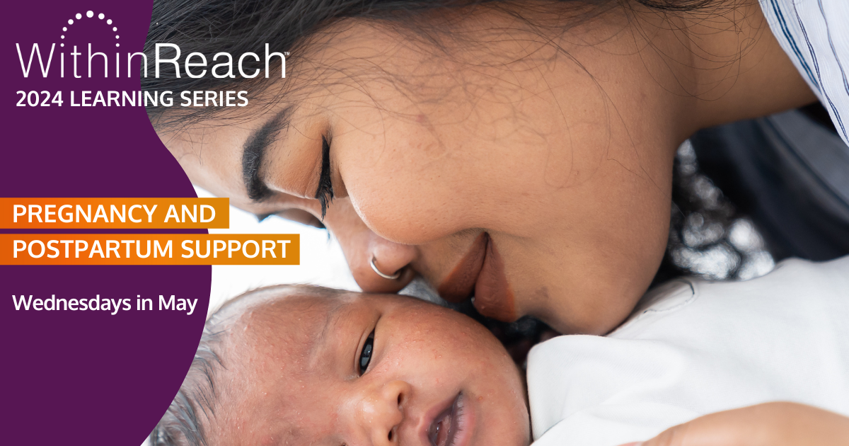
TITLE SLIDE: Photo Option 3
[Copy photo & replace photo on Title Slide: Option 1]

Slide 3
We want to acknowledge that we occupy the ancestral lands of the Coast Salish Peoples, in particular the Tulalip, Snohomish, Stillaguamish, Suquamish, Muckleshoot, Nisqually, Puyallup, and the first people of Seattle, the Duwamish People, past, present and future. We honor with gratitude the land itself.
We also want to recognize that the United States as we know it was built at the often-fatal expense of forcefully enslaved Black and Indigenous people. We must acknowledge that much of what we know of this country today, including its culture, economic growth, and development has been made possible by the labor of enslaved Africans, their descendants, and Indigenous peoples past and present. Today, we are indebted to their labor and the labor of many Black and brown bodies that continue to work in the shadows for our collective benefit.
Land and Labor Acknowledgement
2024 Learning Series: Pregnancy and Postpartum Support

Slide 5
Harm Reduction Doulas
Improving health and wellness for
pregnant people who use drugs
Doulas: Chelsie Porter and Ash Woods

Slide 6
Overview
Define the role of a harm reduction doula
Describe how harm reduction doulas aim to reduce preventable deaths and improve care for birthing people who use substances
Identify best practices for supporting pregnant and parenting people who use substances

Slide 7
Who we are: The Harm Reduction Doula Collective
We are a collective of full spectrum doulas providing harm reduction services in Seattle, Washington.
Companion parents and families who use substances
Full spectrum doula support and community resources
Services are free
Harm reduction training

Slide 8
What is a doula?
Doulas provide information, emotional and physical support to birthing people and their families.
Not medical professionals
Doulas can take trainings and continuing education to gain skills and knowledge
Evidence shows that doulas improve outcomes for birthing people and babies

Slide 9
What is a full spectrum doula?
A full spectrum doula provides support for all reproductive care outcomes.
Prenatal (before the birth), throughout labor and childbirth
Postpartum (after birth)
Miscarriage or stillbirth
Abortion
Bereavement or loss
Care for non-reproductive experiences (dying, gender affirming support or transitions)

Slide 10
What is a harm reduction doula?
A harm reduction doula provides support for pregnant and parenting people who use substances or that are in recovery.
Full spectrum care - supporting ALL reproductive outcomes
Harm reduction supplies and supports
Outreach and transportation

Slide 11
What is a harm reduction doula?
Client led advocacy and decision making
Educating community
Information on CPS engagement and knowing your rights

Slide 12
THANK YOU!
You can visit us at https://www.harmreductiondoulas.org/
Or email us at
info@harmreductiondoulas.org

Slide 13
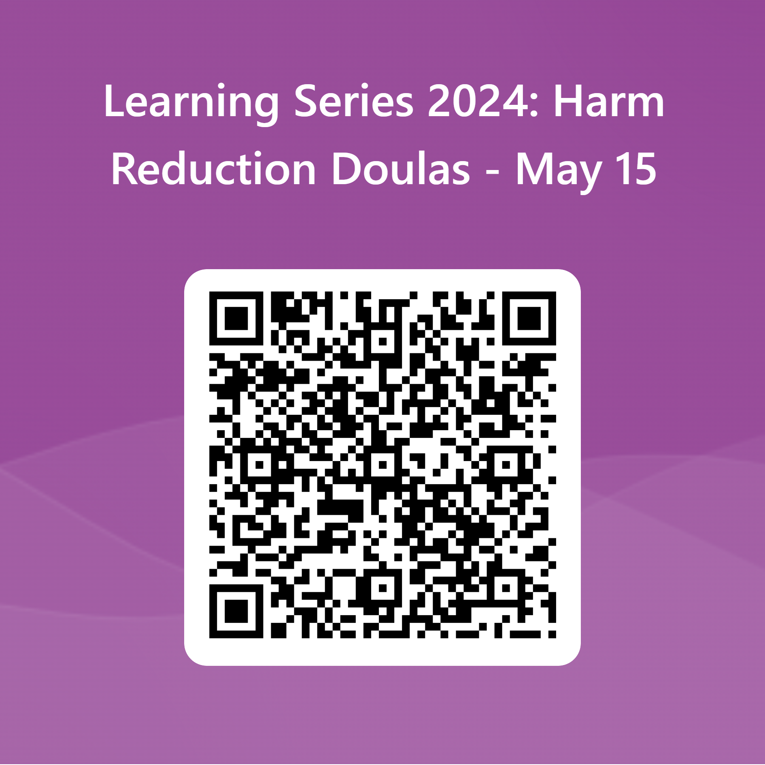
Thank you for attending today's session
We want to hear from you. Please fill out the survey.

